Slide 1
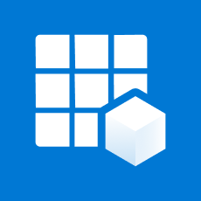





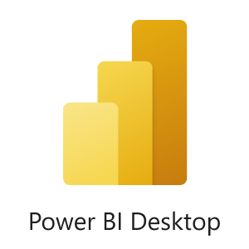
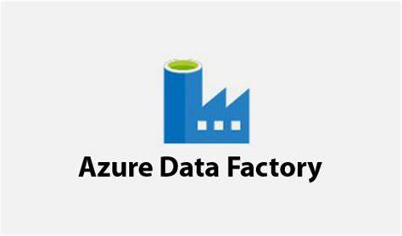
App Registration
Key Vault
Raw Data
Data Transformation
Data Analytics
Data Sources
Dashboard
Data Lake Gen 2
Transformed Data
Data Ingestion
Azure Synapse Analytics
Data Lake Gen 2

